Slide 1

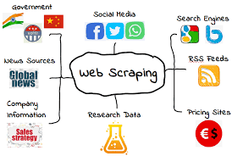
Intro to Web Scraping
Web Scraping Workshop
Learn How to get real data from any website

Slide 2



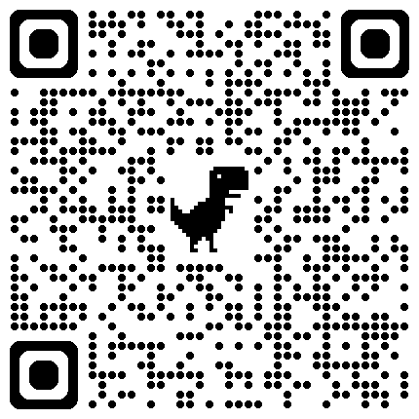


Workshop/Event
Attendance
Membership
Form

Slide 3

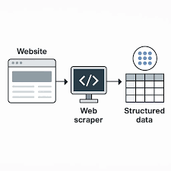
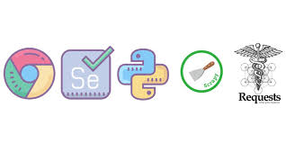
What is Web Scraping?
Web Scraping Workshop
Getting data directly from websites automatically
One of the best ways to get data for a project

Slide 4
Why Learn Web Scraping
Web Scraping Workshop
Automate Data Collection
Gather information not readily available
Monitor Change Over Time

Slide 5



Libraries Used for Web Scraping
Web Scraping Workshop
Beautiful Soup
Selenium
Requests

Slide 6
How Scraping Works
Web Scraping Workshop
Outline
Request: Send a request to a website
Parse: Use selenium or Beautiful Soup to parse the HTML of the website
Extract: Extract data from the HTML and save it in a usable format. (typically a data frame)

Slide 7
Beautiful Soup VS Selenium
Web Scraping Workshop
Beautiful Soup
Selenium
Faster
Easy to learn
Integrates well with requests
Only used for parsing
Can interact with the website
Handles dynamic websites that use JavaScript
Slower
More resource intensive
Barrier to entry

Slide 8
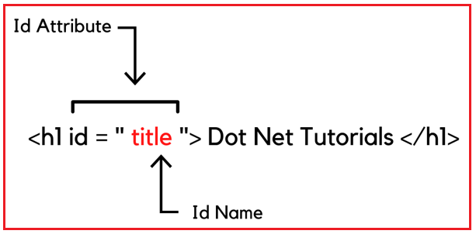
HTML Structure
Web Scraping Workshop
Elements can have unique identifiers called id and class. Id is specific to an element, but class can be shared
HTML Elements
An HTML element is everything from the start tag to the end tag
The best ways to locate specific elements is first by id, then class or tag

Slide 9
Ethics of Scraping
Web Scraping Workshop
Robots.txt
Delays
Copyright
Private Data

